Slide 1

Basic Health Information System API
System solution approach, and design for managing health programs and client registrations.
https://github.com/CHRISKINUNGI/Health_Info_System
By: Chris Kinungi
Notes:
1

Slide 2





My Approach to the Problem
FastAPI
Supabase
RESTful Api
High performance
Documentation generation
Easy to understand and maintain
Managed PostgreSQL
Real-time capabilities.
Very Scalable
Standard HTTP methods (GET, POST, PUT, DELETE)
Architecture
Notes:
4

Slide 3
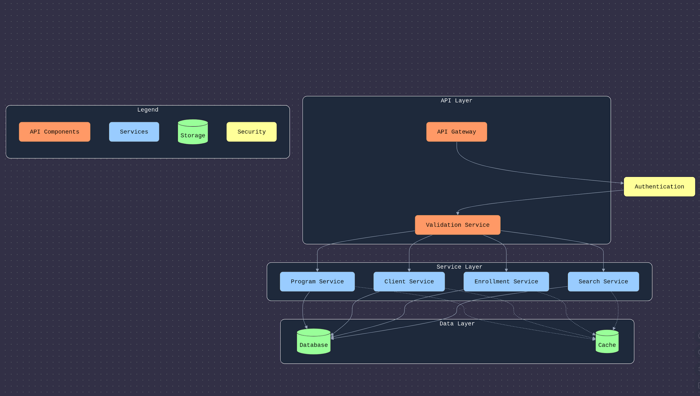
System Design and Architecture

Slide 4
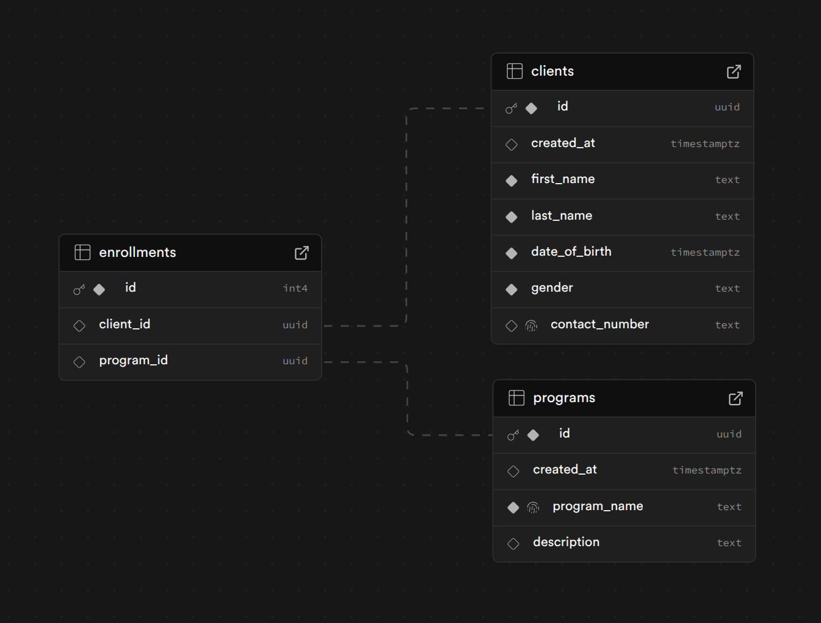

Database Design
KEY

Slide 5






API Design & Implementation
Client Management
User | Doctor
Manage system users
Register and list clients
Get Client Profile and Expose Via Api.
Program Management
Add and list programs.
Enrollment Management
Enroll clients to one or more programs by using The Client Id and Program ID.
Search
Search Client from pool of registered Clients
Documented with OpenAPI for easy access.

Slide 6
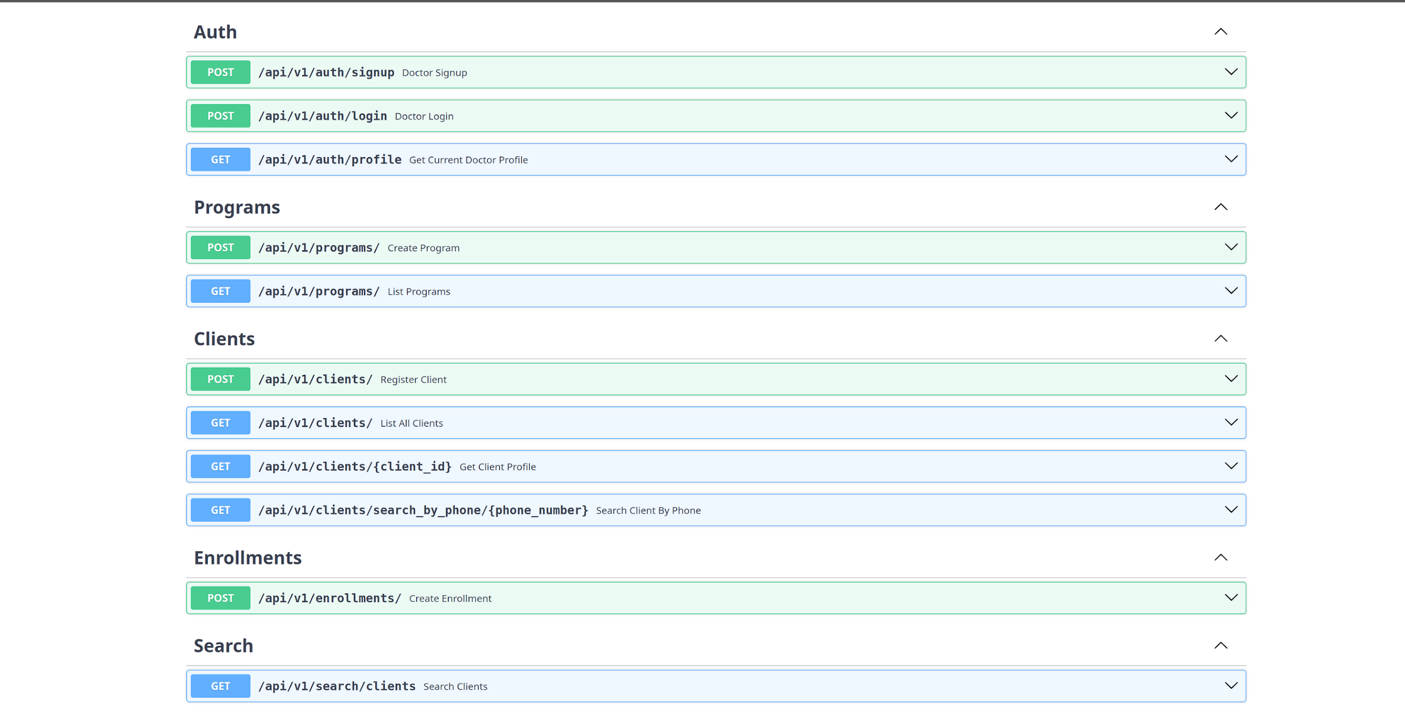
Api Endpoints

Slide 7


Achievements
Security
Scalable
Efficient
Data encryption
JWT security
Handle increasing data amounts.
Code modular Approach
Error handling
Pagination when getting data
Extensible API for future features.
Notes:
10

Slide 8

THE END
Notes:
9

